Slide 1
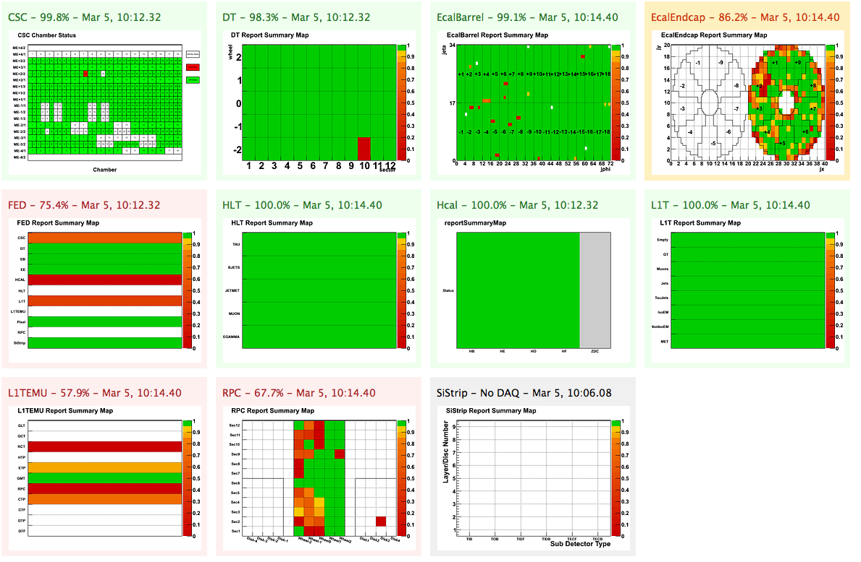
CMS data quality monitoring: systems and experiences
On behalf of the CMS collaboration
Lassi Tuura, Northeastern University Andreas Meyer, DESY – Ilaria Segoni, CERN Giuseppe Della Ricca, INFN Sezione di Trieste; Università di Trieste
CHEP’09 – Prague – 21-27 March 2009

Slide 2
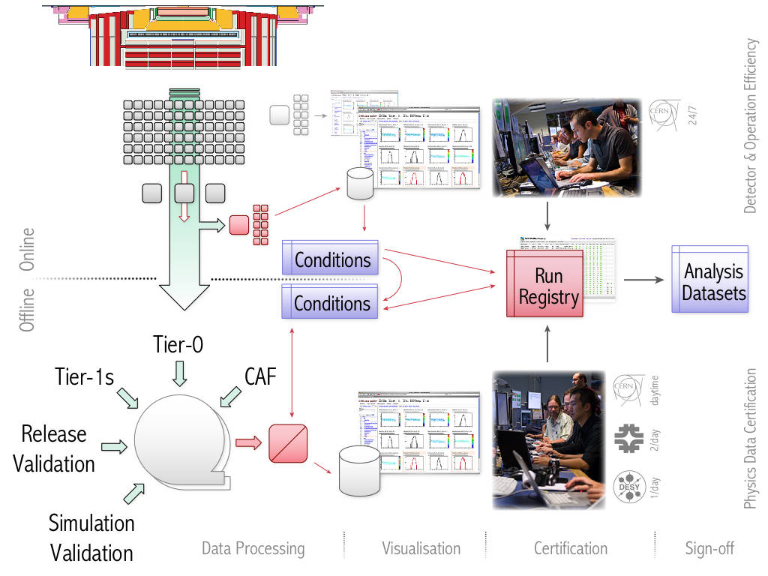
DQM end to end
Notes:
DQM: determine data quality from event data – same look and feel through the chain: online, offline, caf, relval, simval
Online: live (secs) + file archive; live feedback to experts and shifts about detector (hardware) status; make online dqm results available to offline analysis and processing
Offline (Tier-0/Tier-1): re-determine detector (hardware) status using full reco and full event stats; monitor physics objects reconstruction; tier-0 prompt reco to file archive (~1 day); caf al-ca to file archive (hours – days)
Data certification: determine detector quality bits, sign-off procedure and publication dbs (analysis data sets)
Release and simulation validation, pre-production testing
DQM output from CAF data processing
Not shown: -shift organisation, instructions, tutorials, supervision
- development, standardisation, integration (code, workflows, servers, sign-off procedures); vsualisation: histograms, quality tests and reference distributions, graphical detector synoptic views, trend plots, etc.
- wbm from conditions to shifter in online

Slide 3
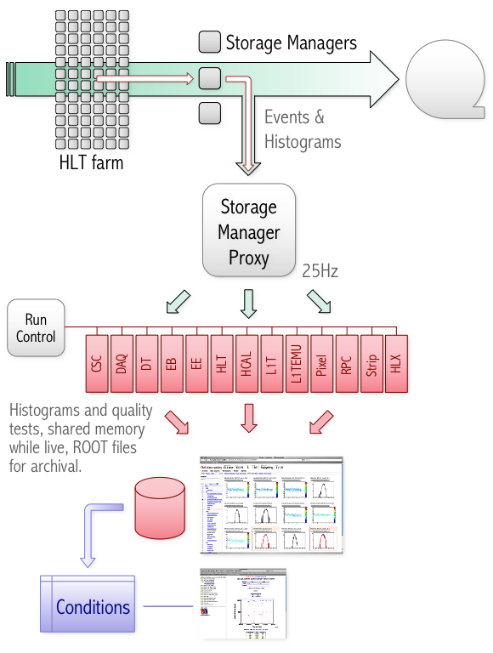
Online DQM
Aim is efficient detector and operation by giving detector and trigger status feedback to experts and shifters.
Live display at ∆t ~ seconds plus 1TB space for the archive of recent runs accessible to the entire CMS in real time.
~300k histograms produced on DQM cluster, ~50k shown in GUI. HLT: 15 trigger monitoring, 3x8 FED subsystem histograms.
Continuous, dead-line free integration of the full DQM chain in a replica playback system.
Online results, initial run summary made available to offline analysis and processing.
Includes online detector quality summary and other key values in conditions database.
Notes:
In production since mid-2008.
Several independent DQM histogramming applications, one or more per subsystem.
Visualisation of live and archived histograms in a single central web-based GUI.
WBM for browsing entities in the conditions database, including key DQM parameters such as detector quality summary.
Replica playback system for integration, dead-line free continuous operation.

Slide 4
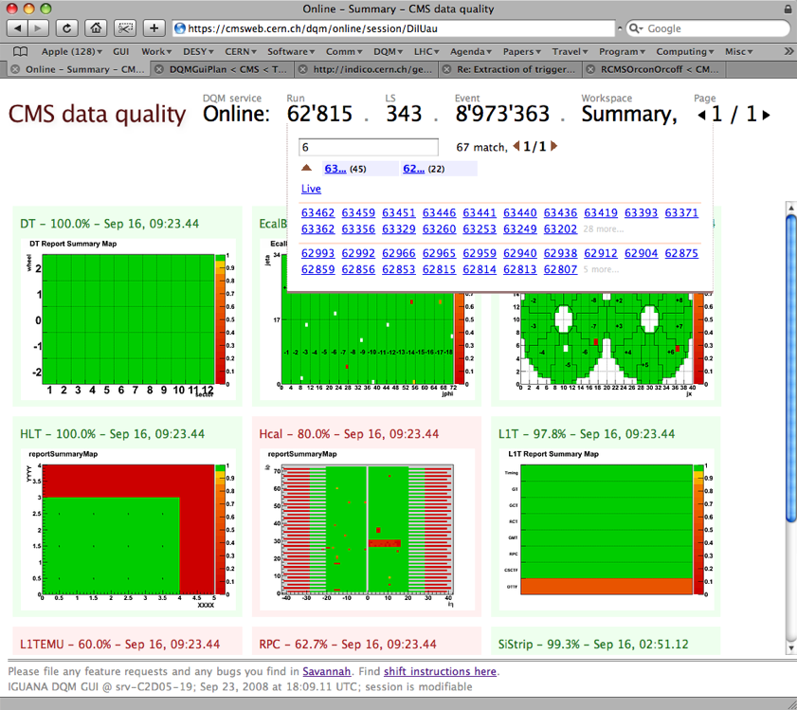
Standard high-level overview
Access to live and
archived runs in a central web GUI.
Standard high-level subsystem summary as a 2D map.
☛ 234: DQM GUI

Slide 5
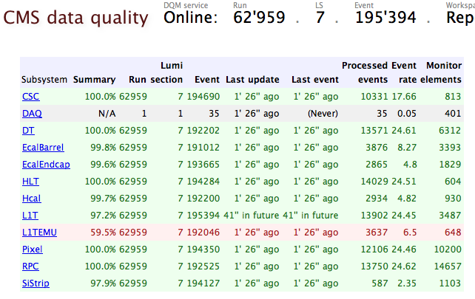
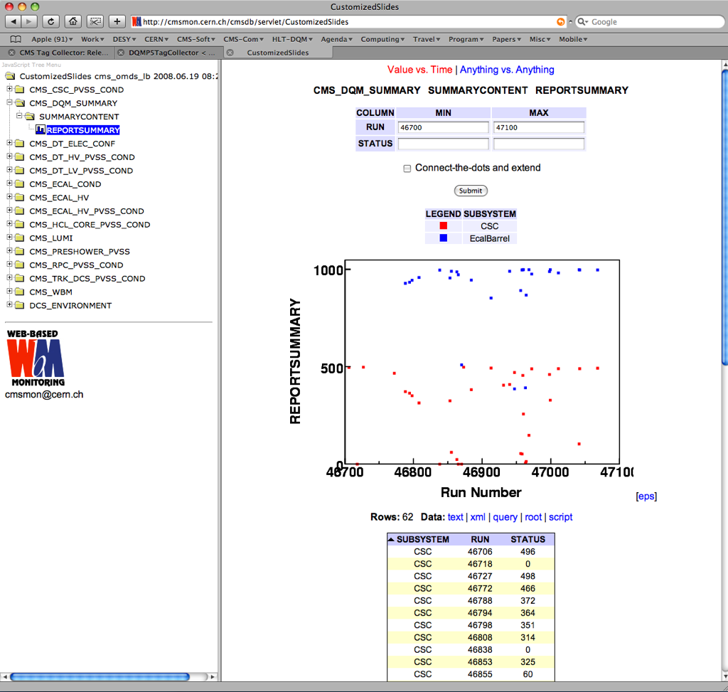
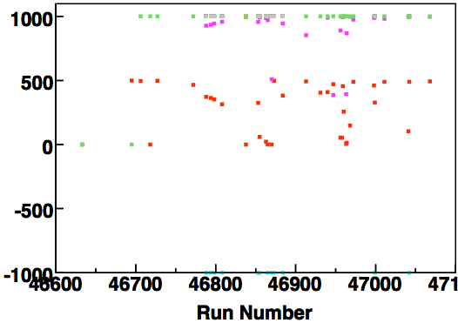
Standard high-level reports
Per system quality summary, copied automatically to the conditions database at the end of the run and accessible in WBM.
☛ 320: WBM/ECAL

Slide 6
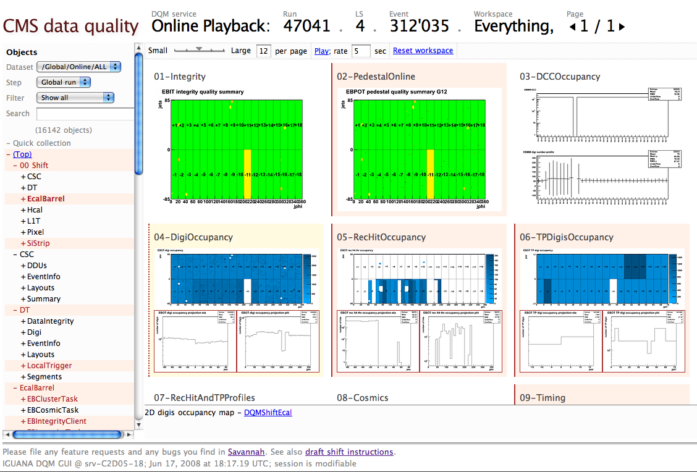
Standard shift views
Standard per-subsystem shift views with links to the shift documentation
Tested on playback system!

Slide 7

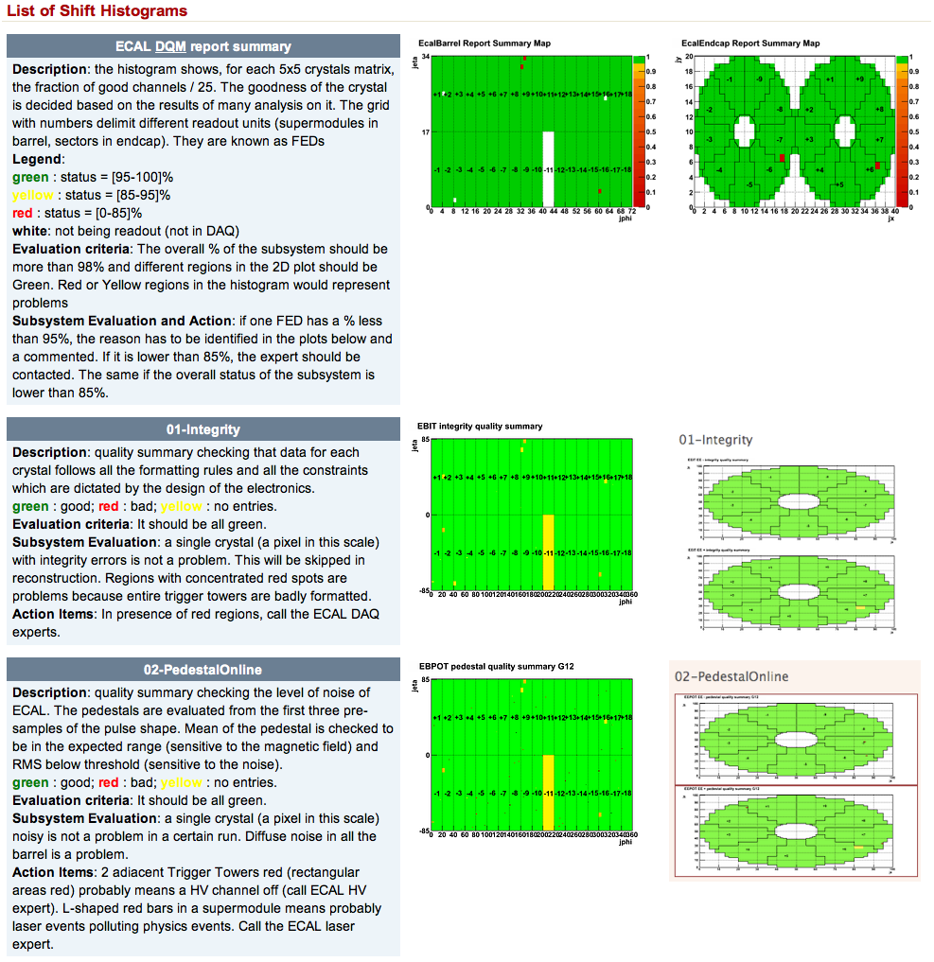
Shift operation
Online DQM shifts operated at Point-5, with remote assistance from remote centres.
Offline DQM shifts operated from the CMS centres at Meyrin, FNAL and DESY.
Standard shift instructions have been fully exercised. Perpetual effort to optimise histograms to maximise sensitivity to problems, to standardise the look and feel and to improve efficiency through better documentation.
☛ 64, 67: CMS centre

Slide 8
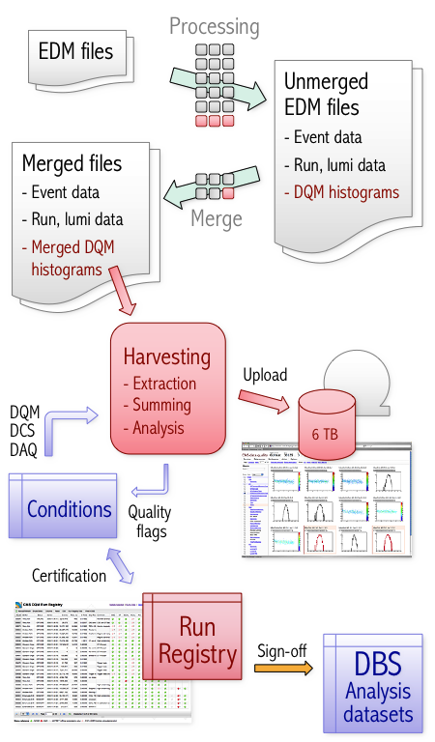
☛ 114: EDM
Offline DQM
Prompt, Al-Ca and re-reconstruction, and simulation, release validation all use the same processing model.
Histograms created in jobs, saved in normal data files, harvested periodically and merged into full statistics with DAQ, DCS info and finally tested for quality and summarised.
Resulting histograms are uploaded to the GUI web server hosted at CERN, backed up to MSS and recent files copied to AFS.
Final quality summary flags are stored into condition database for certification.
Differences are in content and timing. Tier-0, Tier-1s re-determine detector status using full event statistics, full reconstruction, plus add monitoring for physics objects; Tier-0 ∆t ~ one day, Tier-1s days+. CAF ∆t hours to days on Al-Ca entities. Validation verifies MC data.
Notes:
Harvesting in production since 4T run in autumn 2008, certification first accomplished on 4T reprocessing in 2009.

Slide 9
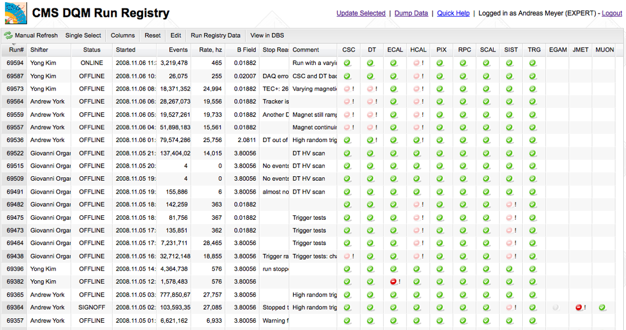
Run registry is our central workflow tool which both steers the process and tracks certification and quality knowledge, including manual notes. It interfaces with the conditions databases and the dataset bookkeeping system. Online and offline shifters add initial notes, detectors and physics groups add certification from DQM, and the final results are confirmed in weekly sign-off meetings.
Notes:
Harvesting in production since 4T run in autumn 2008, certification first accomplished on 4T reprocessing in 2009.

Slide 10
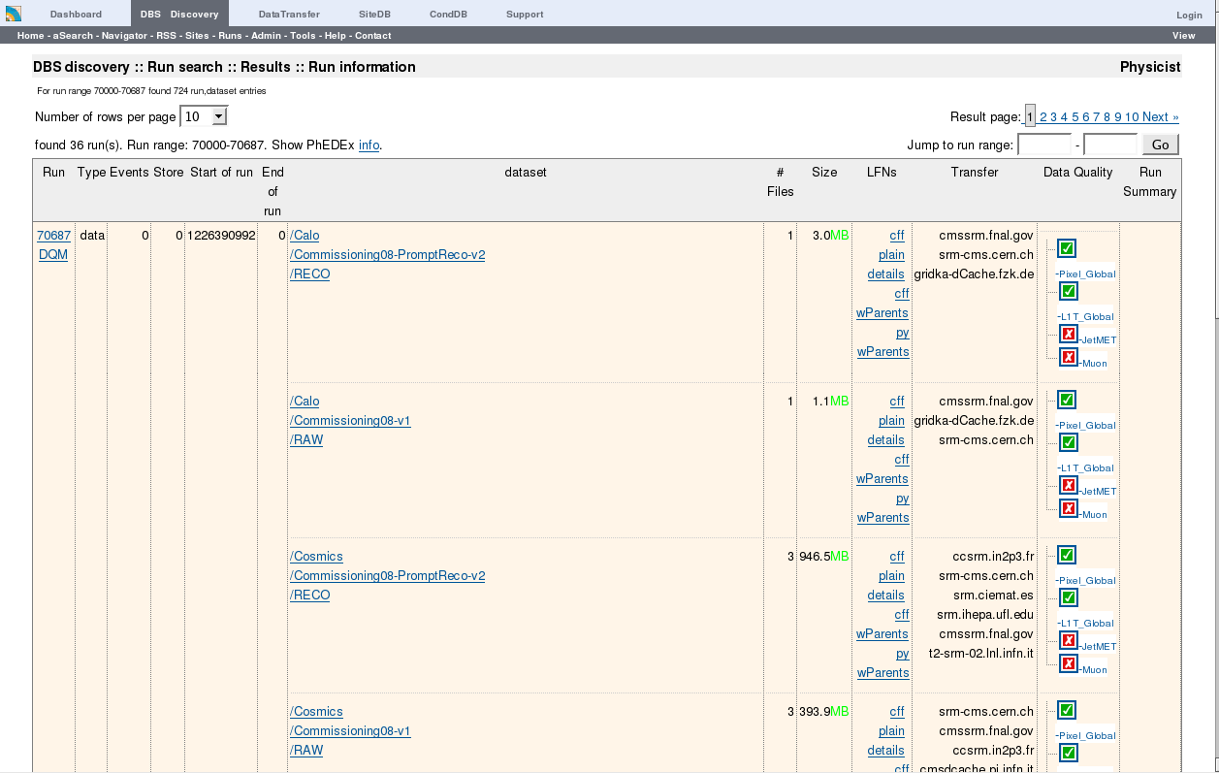
Quality flags uploaded to the dataset bookkeeping system are available for in the data discovery and query interfaces and are also used to defined analysis datasets. The flag assignments are versioned in case revisions are needed.
☛ 111: DBS
Notes:
Harvesting in production since 4T run in autumn 2008, certification first accomplished on 4T reprocessing in 2009.

Slide 11
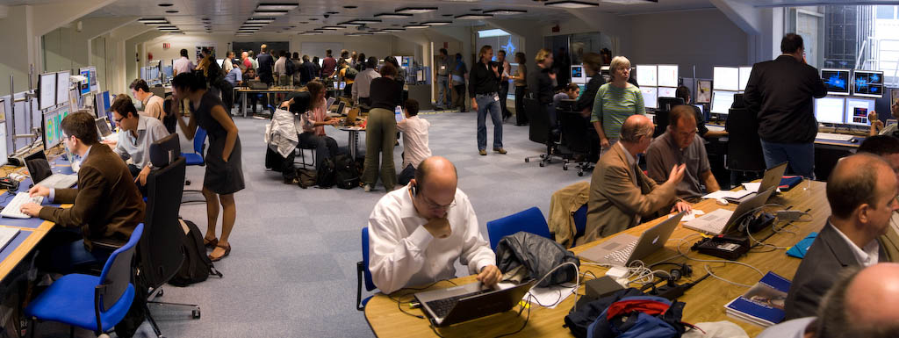
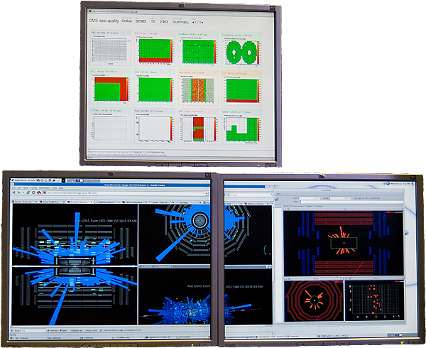
↑ CMS centre at CERN Meyrin site, 10 Sept 2008. Dozens of screens visualise DQM histograms live.
← One of the DQM and event display stations.
☛ 61: LHC first beam

Slide 12
Experience and Summary
CMS has commissioned a full end to end data quality monitoring system in tandem with the detector over the last two years.
Online DQM has been in production for about a year and the full offline chain has now been commissioned. We have just recently completed the first full cycle of certification and sign-offs. DQM for the less structured alignment and calibration at CAF exists but a fair amount of work remains.
In our experience it takes about one year to commission a major component such as online DQM to production quality.
Shift organisation, instructions, tutorials and supervision are major undertakings in their own right.
We have so far focused on commissioning a common first order DQM system through-out the entire experiment.
Second order features will come later.
Modest amounts of code for DQM core. The time goes into developing DQM algorithms, standardisation and integration of workflows, procedures, code, systems and servers.
Very modest manpower for DQM itself, a truly collaborative effort with a lot of people from numerous other projects: trigger, detector subsystems, offline and physics software, production tools, operators, etc.
We are pleased with DQM visualisation served using web technology and operating shifts from the CMS centres. These have been practical enabling factors.

Slide 13
For more information...
Unfortunately details beyond the talks and posters at this conference are limited to CMS collaborators only due to the September 2008 security breach. We think e-mail might not be cut off, you can try to reach us at:
Andreas Meyer andreas.meyer@cern.ch Ilaria Segoni ilaria.segoni@cern.ch Lassi Tuura lassi.tuura@cern.ch Giuseppe Della Ricca giuseppe.della-ricca@ts.infn.it

